Slide 1
Nutritional Discordance: How do methodological choices influence estimated nutrition outcomes? A case study of methods and measures from Bangladesh
Lila Cardell
University of Illinois at Urbana-Champaign
Erin Lentz
University of Texas at Austin
International Policy and Development Seminar
October 2020
Notes:
I started this paper about a year ago, but have struggled to figure out how to focus or frame it. I met Erin at a conference last year and told her I was a huge fan of her work and she had reached out to me to work on this paper looking at intrahoushold nutrient inequality. When I started looking through the paper I had a lot of questions about how a researcher starts with survey data and answers questions about inadequacy and inequality. This paper is very much in progress and I agreed to Alex’s request to present as a commitment mechanism to keep pushing forward, because I believe its important.

Slide 2
Motivation: Malnutrition
Malnutrition is a persistent challenge globally (WHO, 2020)
Undernutrition (wasting, stunting, underweight)
Micronutrient deficiencies and excesses
Overweight , obesity, and other diet-related non-communicable diseases
Long term effects on mortality, ill health, impaired growth and cognitive development, and economics
Estimated economic impact of as high as US$3.5 trillion per year
National Nutrition policies exist in 167 countries
Inconsistent reporting of health and nutrition data (Global Nutrition Report, 2020)
Notes:
Malnutrition remains a persistent challenge, as 1 in 9 nine people globally is hungry or undernourished, while one in three is overweight or obese. And over 20% of children under the age of 5 are stunted and over 30% of women of child-bearing age are anemic. There are long term effects of malnutrition on health, developmental, and economic outcomes, with an estimated impact of 3.5 trillion per year.
Malnutrition is also a significant focus of government attention and donor funding. 167 countries have national nutrition policies. The Global Nutrition Report estimated development aid for nutrition of about 1.25billion US annually. Nutrition goals are being integrated into a variety of targets across agricultural, social, educational, and economic initiatives, without consistency on measurement of nutritional outcomes. The INDEXX project and some other initiatives are working to streamline collection and standardization of data.

Slide 3
Motivation: Intrahousehold Inequality
Women, infants, children and adolescents are at particular risk of malnutrition (UN Women, 2012)
Limited access or power over household resources
Lower priority at meals
Different micronutrient needs than men
Existing evidence on nutritional inequality
Caloric Intake: Berhman and Deolaliker (1990); Pitt et al. (1990); Haddad et al. (1995); Sununtnasuk and Fiedler (2017); Brown et. al. (2019)
Dietary diversity: Mangyo (2008); Villa et al. (2011); Rahman (2013)
Nutrient adequacy: Coates (2017) and Coates (2018)
Body Mass Index: Sahn (2009); D’Souza and Tandon (2018)
Notes:
There has also been an increased focus on gender with respect to attention and funding. Women and girls are commonly assumed to be at greater risk of food insecurity and malnutrition. Earlier research examined whether women consume a lower percentage of their required daily caloric intake, but the evidence remain scarce. In recent years, that focus has shifted to nutrient intake, dietary diversity, and anthropometric outcomes, recognizing that caloric intake is only one measure of nutritional status. However growing interest in the relationship between intrahousehold inequality and nutritional adequacy has not been always been accompanied by a closer relationship between social scientists and nutritionists.

Slide 4
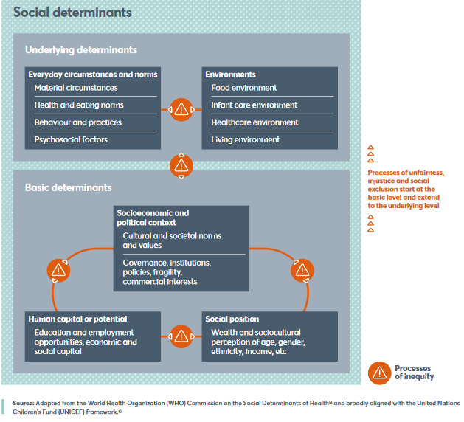
Motivation: Nutrition Inequities Shift to incorporate inequity into assessments, analysis and reporting (Global Nutrition Report, 2020)
Notes:
Lastly, there has been acknowledgment from the nutrition sector that that malnutrition and intrahousehold nutrient inequalities are not solely household or individual level issues and that there are broader systemic inequities. Factors such as socialeconomic and political context need to be incorporated into measurement to help identify issues and develop solutions, increasing the importance of cooperation and consistency.

Slide 5
Motivation: What is being measured?
How is nutritional inadequacy identified?
Caloric intake and dietary diversity measure availability and access to food
Nutrient adequacy can measure availability and access to nutrients
Anthropometry measures a combination of availability, access, and utilization of food and nutrients
Individual vs group inadequacy
What is the relationship between the distribution of intake requirements in a group and the distribution of intakes in a sample?
What is the relationship between the distribution of an individual’s usual intake and the intake requirements of a group?
How is nutritional inequality measured?
No consensus on intrahousehold bargaining models, which require identifying individual inadequacy
Intergroup models such as boys vs. girls allow for group level inadequacy
Notes:
So despite the evidence generated on nutrient outcomes as a result of policies, I don’t fully understand or feel confident in what is being measured or how it is being measured.
First, the question is not: what data is available, but what is the? Is it individual or household availability of food, or allocation of food? Or is it individual utilization of food or individual health status, in which case anthropometric measures may be more applicable. Not all measures answer the same question.
Second, there is inconsistency on the level of aggregation in nutrition measures, whether it is identifying individual inadequacy and then averaging across a sample, or identifying inadequacy in the sample as a representation of population level inadequacy. This is especially important for intrahousehold inequality measurement, which requires individual level inadequacy measurement despite it being more demanding in terms of data and statistical method. The concern applies for identifying both the frequency and extent of inadequacy. This is dissimilar to a lot of social science research, where you might compare your casual effects to the effects estimated by another paper, but there is no formal definition of “poverty” or “adequate welfare”. Here, there are rigorous scientific definitions for inadequacy, but they have not been consistently used by social scientists.
Lastly, the lack of consistency on intrahousehold inequality methods as they apply to nutritional inequality makes it difficult to compare across contexts.

Slide 6
Overview
Motivation
Research Questions
Decision Mapping
Household level data
Individual level data
Sensitivity Analysis
Reference Weights and Heights
Adult Equivalents
Energy Inadequacy
Next steps
Notes:
So I have gone through a bit of the motivation. Next I’ll specify a few research questions, talk about the decisions that a researcher makes in trying to answer nutrition questions, and then use the Bangladesh Integrated Household Survey to show the impact of a few of those choices on outcomes.

Slide 7
Research Question 1: How do our measurement choices influence our findings?
Inadequacy Measure for Individual_j
Inadequacy Measure for
individual_i for
nutrient consumption
Household Survey Data
START
Individual Survey Data
Measure of inequality between individual_i and individual_j
END
Notes:
In theory, the goal of nutrient inadequacy and inequality research is to identify how many and which foods (and therefore macro and micronutrients) each household member consumed and compare those amounts against other members’ intakes within a household or across age-sex groups.. However, to engage in this comparison requires multiple choices.
First, we want to understand what choices we make between identifying survey data and nutrient outcomes and the impact of those choices on findings.
If we can map those decisions, we can determine the extent to which measurement choice influences findings of nutritional discordance. It’s possible that the methodological choices are driving inequality outcomes, and unitary models of households are appropriate. Collecting household level data is far easier and less costly than individual level data. However, a risk of assuming unitary households is that we might misidentify the number of food insecure individuals and the severity of the insecurity experienced. An important step is to identify how sensitive results that are discordant are to the choice of method.

Slide 8
Research Question 2: What are the best practices for measurement?
Inadequacy Measure for Individual_j
Inadequacy Measure for
individual_i for
nutrient consumption
Household Survey Data
START
Individual Survey Data
Measure of inequality between individual_i and individual_j
END
Notes:
Second, based on our findings, we aim to provide guidance on best practices for measurement. A better understanding of nutritional discordance is critical for food, agriculture, nutrition, gender, and social protection policy. A clearer understanding of how to measure such effects, and when it is useful to do so can help researchers and practitioners recognize when household bargaining matters and how to design program interventions better achieve desired impacts.

Slide 9
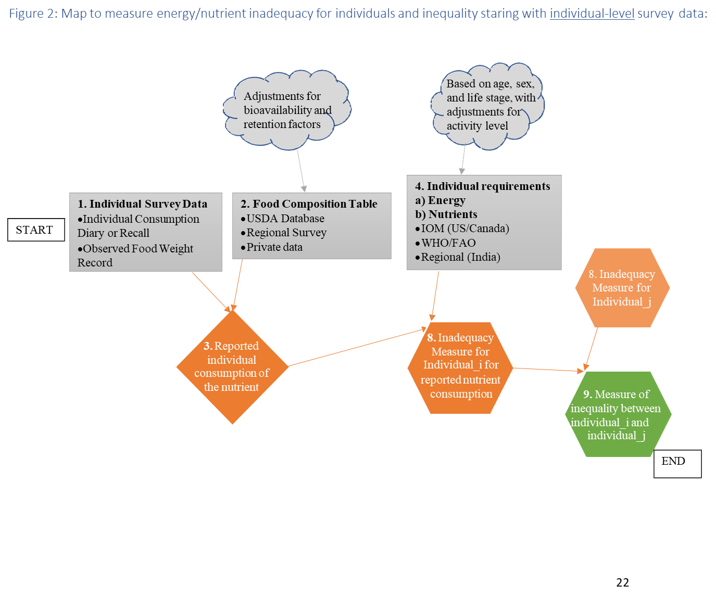
Figure 1: Map to measure energy/nutrient inadequacy for individuals and inequality using individual survey data:
Notes:
So the first map is how to identify inadequacy and inequality when you are starting from individual level data, which can be in the form of consumption diaries or recalls or observed food weight records. Individual consumption diaries or recall surveys often ask the respondent to identify consumption over a 24-hour period. This short time frame can miss day -to-day variation in consumption patterns or preferences that can only be seen with a longer survey period
The second gray rectangle is the choice of food composition tables which convert the food items reported in the dietary data sets into energy and nutrient values. Chemical analyses determine the nutrient content of the foods in the food composition tables (CITE). The USDA, for example, provides a comprehensive database however, the quality and nutritional profile of foods can vary both across and within countries. For these reasons, research in non-US countries, it may be preferred to use regional food composition tables, which may provide greater accuracy in nutrient content and availability and may contain the local names of items to increase likelihood of identification. Finally, a combination of food composition tables may be required to identify all consumed items, as well as to standardize food sizes and quantities. Adjustments can also be made for bioavailability of nutrients and cooking retention factors.
These two items are used to convert the survey data into the reported individual consumption by matching food items in the survey with food items in the database and converting quantities to determine the caloric or nutrient quantity for the food reported in the survey.
The gray rectangle labeled with a 4 determines the energy and nutrient requirements. Researchers must choose (1) the nutrient(s) of interest, (2) the source of nutrient requirements, and (3) the appropriate reference standard for the group or individual, which includes decisions about incorporating attributes such as age, sex, physical activity level, life stage, and reference height and weight. More precision on these attributes increases the likelihood that the appropriate nutrient intake standard is used as a benchmark. For example, a sedentary woman aged 65 and five feet tall does not require the same nutrients as an 18-year-old, physically active six foot tall man. While some datasets do not include all pertinent information and therefore researchers are forced to use a reference group that fits the characteristics available, some researchers also make simplifying assumptions, ignoring, for example, activity levels.
Requirement type refers to energy or macro or micronutrient adequacy. The two main sources of requirement standards are the Institute of Medicine which is a US/Canadian effort that published standards in 2006 and have been updated since. There are WHO/FAO guidelines for energy requirements and some macro and micronutrients but they have not been validated as rigorously. The WHO has published guidelines for weight and heights are seen as the global standards, and I’ll discuss that more during the sensitivity section.

Slide 10
Term | IOM | WHO/ FAO | India | For assessing the probability of inadequacy for an individual (IOM) | For assesing the prevalence of inadequacy of a group (IOM)
Average Requirement (AR) | Estimated Average Requirement (EAR) | AR | AR | use to examine possibility of micro or macronutrient inadequacy, using z-scores that account for the requirement and intake distributions* | use to estimate prevalence of inadequate micro or macronutrient intakes within a group using the probability approach or cut-point method
Recommended intake level (RI) | Recommended Daily Allowance (RDA) | Recommended Nutrient Intake (RNI) | RDA / Safe Level | usual micro or macronutrient intake at or above this level has a low probability of inadequacy, no conclusion for intake below this level | do not use to assess adequacy of nutrient intakes of groups
Adequate intake (AI) ** | AI |  |  | usual micronutrient intake at or above this level has a low probability of inadequacy, using z-scores that accounts for intake distribution | mean usual micronutrient intake at or above this level implies a low prevalence of inadequate intakes
Safe upper level (UL) | UL | UL |  | usual micronutrient intake above this level places an individual at risk of adverse effects from excessive nutrient intake, using a z-score that accounts for intake distribution* | use to estimate the proportion of a group at risk of adverse effects from excessive micronutrient intake
Appropriate Macronutrient Distribution Range (AMDR) | AMDR | AMDR |  | observed usual macronutrient intake between the lower and upper bound of the AMDR is within the acceptable range | proportion of the group that falls below, within, and above the AMDR can be used to estimate the proportion of the population that is outside the range of recommended macronutrient intake
Net energy requirement | EER | TEE | TEE | IOM prefers to use BMI to assess adequacy of energy intake, however the EER/TEE is often used like an AR | IOM prefers to use BMI to assess adequacy of energy intake, however the EER/TEE is often used like an AR
Body Mass index (BMI) | BMI | BMI | BMI | BMI below, within, and above the normal range indicates inadequate, adequate, and excessive energy intake | proportion of the group with BMIs below, within, and above the desirable range would reflect the proportions with inadequate, adequate, and excessive energy intakes
Notes:
*for nutrients with a requirement distribution that is skewed, such as iron, a different approach is required
** for nutrients where there is not enough evidence to provide an AR/RI
For all nutrients with EARs that are normally distributed, the IOM recommends using the cut-point method, which assumes that the proportion of individuals with intakes below the EAR is consistent with the proportion of individuals with inadequate intakes of the nutrient. The cut-point method assumes intakes and requirements are independent (not true for energy), symmetrical (not true for iron), and that the distribution of intakes is more variable than the requirement distribution. For nutrients that are not normally distributed, such as iron, the probability method must be used, which averages probabilities (from z-scores) across individuals to estimate the prevalence of inadequacy in a group. This approach assumes that intakes and requirements are independent and that the distribution of intakes is greater than the distribution in requirements
Types of Micronutrient Standards:
Average Nutrient Requirement (AR): the average daily nutrient intake level that is estimated to meet the requirements of half of the healthy individuals in a particular life stage and gender group. The IOM and WHO/FAO calls this “Estimated Average Requirement” (EAR), but as of 2011, NASEM uses the term “Average Requirement” (AR). Although the AR can also be used to examine the probability that usual intake is inadequate for individuals (in conjunction with information on the variability of requirements), it is not meant to be used for recommending daily intake by individuals. The AR may be the mean or the median of the requirement distribution, which is the variability in a requirement across healthy individuals in the age, sex and life stage group. The intake distribution is the variability in nutrient intake for an individual. IOM provides EARs for most micronutrients. (IOM, 2006, 2011)
Individual Recommended Intake: the average daily nutrient intake level that is estimated to meet the requirement of nearly all (97-98 %) of the healthy individuals in a particular life stage and gender group. The IOM calls this “Recommended Daily Allowance” (RDA) while WHO/FAO call it “Recommended Nutrient Intake” (RNI) and NASEM (formerly IOM) use the term “Recommended Intake” (RI). It is the AR + 2SD. The RDA thus exceeds the requirements of nearly all members of the group, and is not recommended for assessing the adequacy of intake for a group, as 97-98% of the population should meet the RDA requirement. It can be used as a guide for daily intake by individuals as usual intake at the RDA should have a low probability of inadequacy. If the RI/RNI/RDA cannot be determined, the Adequate Intake (AI) is used, which the IOM defines as the recommended average daily intake level based on observed or experimentally determined approximations or estimates of nutrient intake by a group (or groups) of apparently healthy people that are assumed to be adequate. The IOM provides RDA and AI for most micronutrients (IOM, 2006, 2011). FAO/WHO provide RDA or AI for some micronutrients, however they have not been validated or updated as closely as the IOM requirements.(FAO, 2001, 2004,2010) India provides RDAs for calcium and iron. (India, 2011)
Tolerable Upper Limit (UL): the highest average daily nutrient intake level that is likely to pose no risk of adverse health effects to almost all individuals in the general population. As intake increases above the UL, the potential risk of adverse effects may increase. This standard is generally used for assessing the safety of dietary recommendations. (IOM, 2006, 2011)
Types of Macronutrient Standards:
Acceptable Macronutrient Distribution Range (AMDR): The range of intakes of an energy source that is associated with a reduced risk of chronic disease yet can provide adequate amounts of essential macronutrients. The AMDR is expressed as a percentage of total energy intake and therefore varies with energy requirements which can be affected by age, sex, height, weight, activity level and life stage group. The AMDR must be converted to grams to be compared to reported or allocated intake levels, based on carbohydrates and protein providing four calories per gram and lipids providing nine calories per gram. The key feature of each AMDR is that it has a lower and upper boundary. Intakes that fall below or above this range increase the potential for an elevated risk of chronic diseases and raise the risk of inadequate consumption of essential nutrients. IOM provides ranges for carbohydrates, protein, and fat intake, by age, gender, and life-stage group. (IOM, 2006)
Depending on the source, an average requirement (AR) or individual recommended intake (RI) may be provided for the macronutrient. IOM provide EARs for protein and carbohydrates that vary with weight. (IOM, 2006)
Recommended Daily Allowances (RDA) may also be available: India provides RDAs for protein and fat requirements. (India, 2011)

Slide 11
Figure 2: Map to measure energy/nutrient inadequacy for individuals and inequality using household survey data:
Based on age, sex, and life stage, with adjustments for activity level
Adjustments for bioavailability and retention factors
4. Individual requirements
Energy
Nutrients
IOM (US/Canada)
WHO/FAO
Regional
START
1. Household Survey Data
Household Expenditure
Household Recall Diary
2. Food Composition Table
USDA Database
Regional Survey
Private data
5. Adult Equivalents (AE)
Ratio of individual energy or nutrient requirements to requirements for base individual
Pre-generated AE
Per capita
3. Reported household
consumption of
the nutrient
8. Inadequacy Measure for Individual_j
6. Individual_i’s Share (%)
= individual_i’s AE
sum of all household AE
8. Inadequacy Measure for
individual_i for
allocated nutrient consumption
7. Allocated individual
consumption of
the nutrient
9. Measure of inequality between individual_i and
individual_j
END
Notes:
This pathway starts from household level survey data and then applies some measure of individual requirement to allocate food within the household. Household expenditure and consumption surveys report household recall of purchases of food and non-food items and consumption over a set time period, often 7 days. Household food diaries typically track food intake over a 24-hour period. Household budget surveys, Living Standard Measurement Studies, Comprehensive Food Security Assessment Surveys are all examples of HCES.
Factors that can affect the quality of the results of a HCES include the length of time covered by the survey, the types of categories or options provided to the enumerators, the likelihood of food consumed away from home, and the level of literacy and urbanization of the household In sum, these surveys are widespread, but not without error. Comparisons of HCES and household food diaries have found that they are comparable in their collection of relevant consumption data

Slide 12
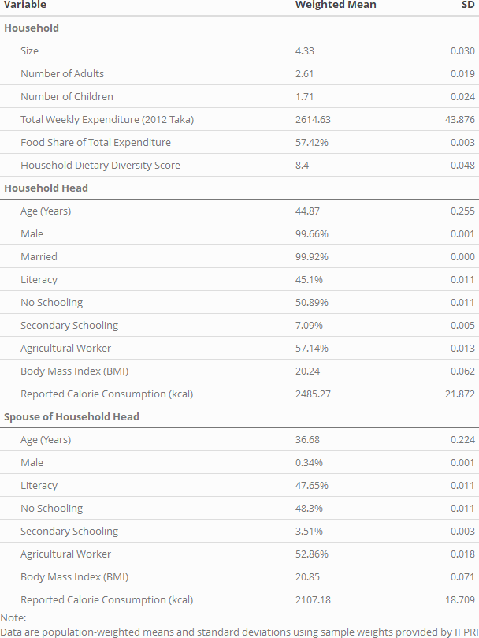
Bangladesh Household Survey 2011-2012 (BIHS)
5503 households
21,442 individuals over 2 years old
Households selection:
Nationally representative of rural Bangladesh
Representative of the rural areas of each of the seven administrative divisions of Bangladesh
Notes:
To compare across methodologies, we use the Bangladesh Integrated Household Survey (BIHS). Bangladesh has invested a great deal of resources in improving child nutrition and reducing mortality. BIHS is a rich, nationally representative survey collected in 2011-12 and subsequently in 2015 of over 21,000 individuals across more than 6500 households. These households were selected to be representative in 3 dimensions: nationally representative of rural Bangladesh, representative of the rural areas of each of the seven administrative divisions of Bangladesh, and representative of the zone covered by the Feed the Future (FTF) program funded by the United States Agency for International Development (USAID) and implemented by IFPRI. The FTF sample contains 1000 households, which we exclude from our analysis. Sampling weights were provided for IFPRI for the remaining 5503 households. Within those 5503 households, we identified 21,442 individuals who were 2 years of age and older and had meal data available. Children under the age of 2 were excluded as identifying intake and nutritional requirements for breastfed children was beyond the scope of this paper.
Statistics for household heads and spouses are included. Nearly all households are headed by married men. Approximately 50% of both heads and spouses are not literate and or have had no schooling. Secondary schooling is uncommon, and over half work in agriculture. The Body Mass Index is 20.24 for household heads and 20.85 for spouses, which is within the range of what is considered healthy by IOM, WHO/FAO, and NIN standards. Reported daily calorie consumption is approximately 2500 kcal on average for household heads, and 2100 kcal for spouses.

Slide 13
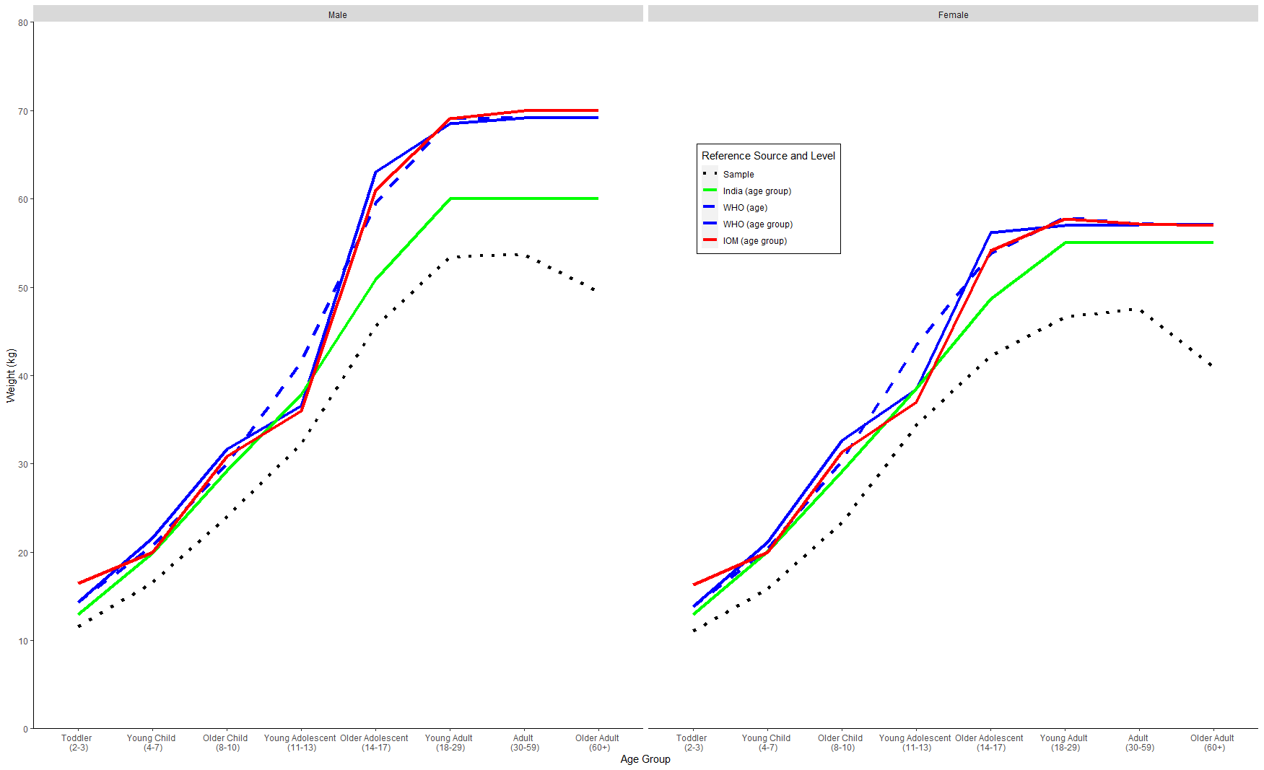
Reference Weights By Source and Aggregation Level
Notes:
This graph shows the differences in reference weight and height standards for men and women.
The IOM energy recommendations (and any nutrients that are a percentage of energy requirements) rely on incorporation of a weight, height, age, and physical activity level into equations given for each age, sex, and life stage group. The WHO/FAO energy requirements (and some nutrient requirements) rely on a weight and physical activity level for a given age, sex, life stage group. Thus, for IOM and WHO/FAO calculations, the choice of weight, height, and age can have a significant impact on energy needs. The energy and nutrient requirements provided by the Indian National Institute of Nutrition are given by age, sex, physical activity, and life stage group, for a set reference height and weight that is also given for that group.
When individual height and weight data are available, researchers can create individual-specific energy requirements by using the individual’s current weight and height. In cases where individuals’ heights and weights are not collected or as a simplifying assumption, the calculations for energy or nutrient requirements are made for the entire age, sex, and lifestage group using the reference height and weight given by the reference source. If activity or occupation data is available, the group-based energy requirement can be adjusted for individual physical activity level to estimate the individual energy requirement. (FAO,2006)
While IOM, WHO/FAO, and India all provide reference weights and heights for age, sex, and lifestage groups, the gold standard recognized by nutritionists are the WHO child growth standards. These standards were published in 2006 using measurements collected globally. The growth standards use measurements for children under 5 and then extrapolate growth references for children 5-19 years old. Heights and weights are given at a monthly level, in contrast to median heights and weights provide by IOM for age sex groups. (IOM, 2006; WHO, 2006) The median heights and weights for 19 year olds are assumed to represent final growth values, and are used as estimates for the median heights and weights for all adults. (IOM, 2006) The WHO did not provide adjustments for pregnant women, however. The IOM provided guidelines for recommended weight gain for healthy women during pregnancy, which can be used to adjust the WHO reference weights for pregnant women. (IOM, 2009)

Slide 14
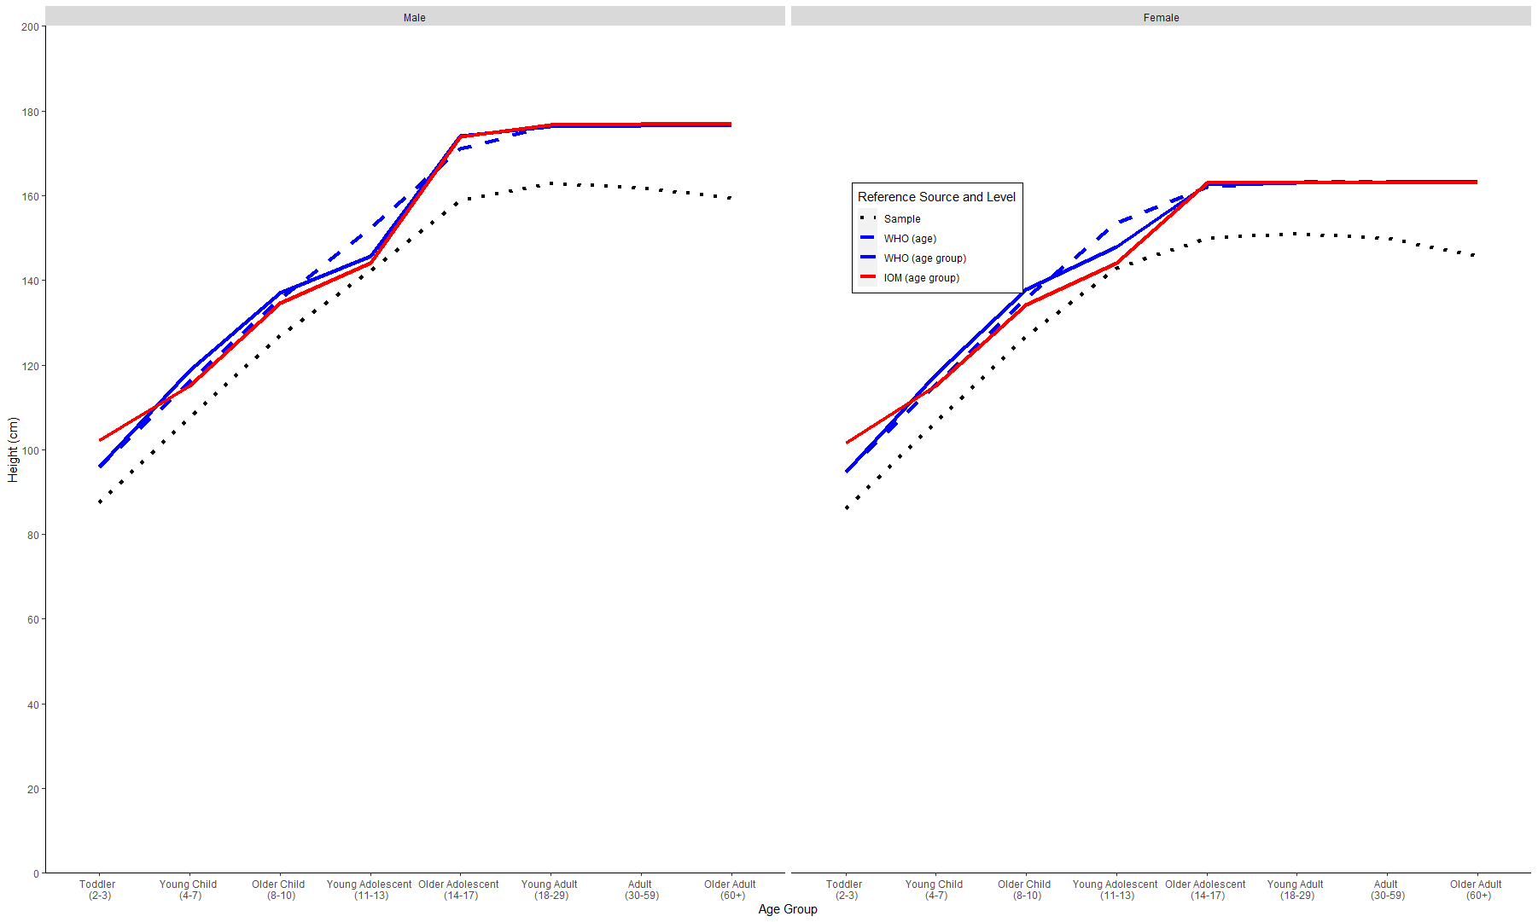
Reference Heights By Source and Aggregation Level
Notes:
Reference Height (male vs female)

Slide 15
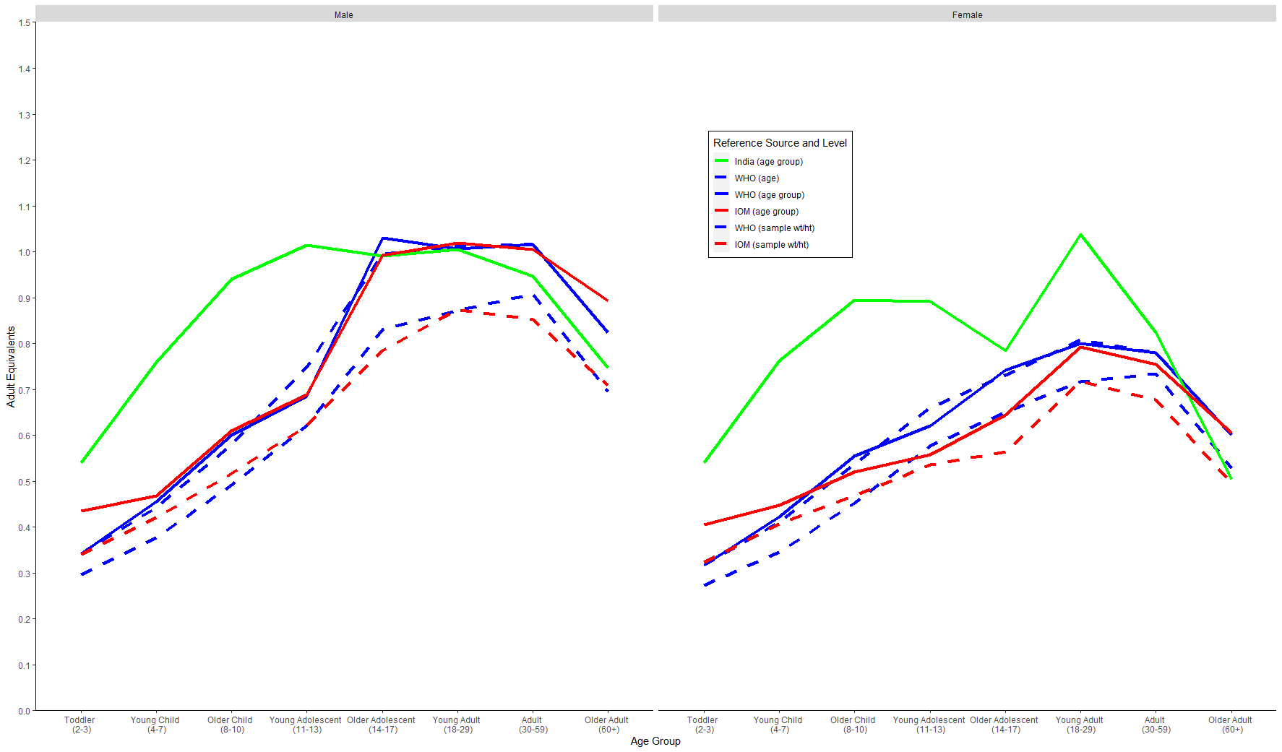
Adult Equivalents By Source and Aggregation Level
Notes:
Adult Equivalents (male vs female)
When consumption data is only available at the household level, various methods are used to assign representative shares to individuals to allocate nutrient consumption. The easiest is the “per capita approach” which allocates calories or nutrients equally among all members of a household. However, this approach assumes that all household members consume the nutrient equally and misses out on household variation due to the different needs of children vs adults, for example (Karageorgou, et al. 2018). A second approach assumes that the share of household nutrient consumption allocated to the individual is proportional to individual nutrient requirements. In this approach, the individual’s energy or nutrient requirements must be identified using the nutrient reference standards. The individual’s “Adult Equivalent” (AE) is expressed as a ratio of the individual’s energy or nutrient requirement relative to the energy nutrient requirement for a base individual, typically an 18 to 30 year-old male with moderate physical activity level.
While an AE can be calculated for each nutrient individually, the AE generated by the relative share of energy requirement is typically used and applied to all nutrient allocations. Coates (2017) calculated nutrient-specific adult equivalents and found that the differences between shares were not significant when compared to using the AE value derived from energy consumption to identify shares for all nutrients.
Could have even compared with or without activity level

Slide 16
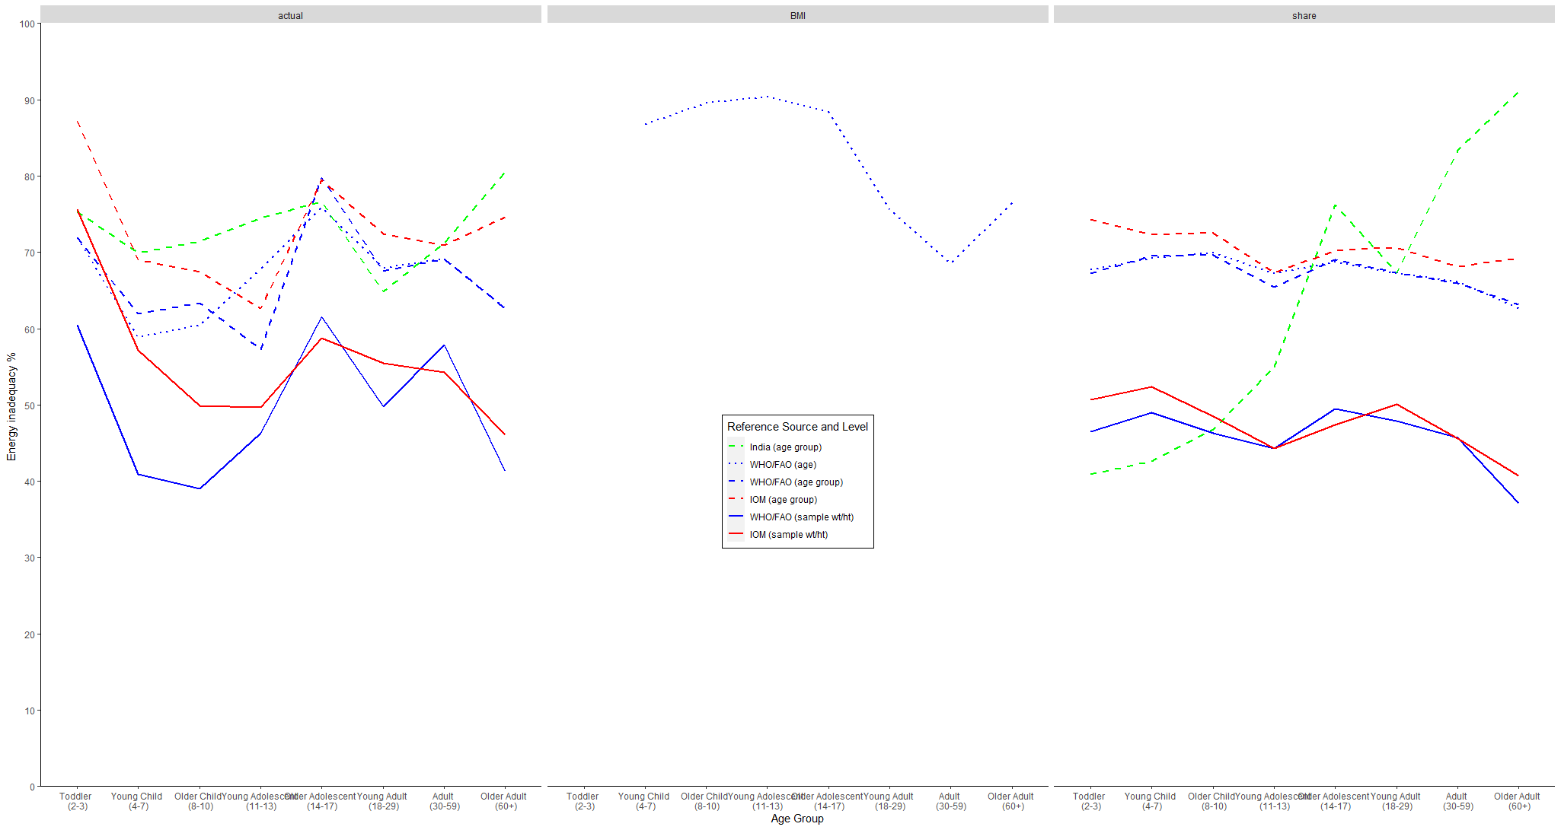
Frequency of BMI and Energy Inadequacy for Men in the BIHS Sample
Notes:
For determining inadequacy: As discussed in Step 4a, there is inconsistency in whether adequacy is determined by comparing actual or allocated intake to the requirement for the individual (based on their actual weight, height, age, lifestage and physical activity level) or comparing actual or allocated intake to the requirement for a reference individual for the individual’s age, sex, and life stage group. Both of these approaches often classify an individual as inadequate if they are below the requirement, with or without adjusting for intake or requirement variability. Inference at an individual level by comparing individual intakes to individual requirements and then averaging across an age, sex, lifestage group suffers from the bias noted in the calculation of individual requirements, as does any comparison of individual intake to a median or mean group intake requirement. Inference at a group-level relies on a variation of the cut-point method used for micronutrient intake assessment, by assuming that the proportion of the group below the intake requirement correlates with the prevalence of inadequacy. The cut-point method relies on the assumption that intakes and requirements are independent, which is unlikely to be true for energy intake: people feel hungry and so they eat more, reflecting accurate signaling and actions. IOM is clear that this assumption prevents application of the probability approach or EAR cut-point method for assessing energy adequacy of a group, but it is still used nonetheless. (IOM, 2006) The magnitude or intensity of energy and nutrient gaps is generally presented as the percentage below the requirement for the proportion of the group with inadequate intake. (Sununtnasak & Fiedler (2017), D’Souza and Tandon (2019)), however this is not consistent.
For all of the reason described above and others related to intake measurement and variability, IOM recommends using Body Mass Index (BMI) standards in lieu of energy intake. The BMI is equal to the individual’s weight in kilograms divided by the square of the individual’s height in meters, and provides a different representation of both energy intake and energy utilization. The WHO provides distributions for appropriate BMI standards by age and sex for all individuals. Observed heights and weights likely have less day to day variability compared to energy and the WHO distributions can be used to make inferences about prevalence of inadequate energy intake in a group. (IOM, 2006; WHO/FAO, 2006)

Slide 17
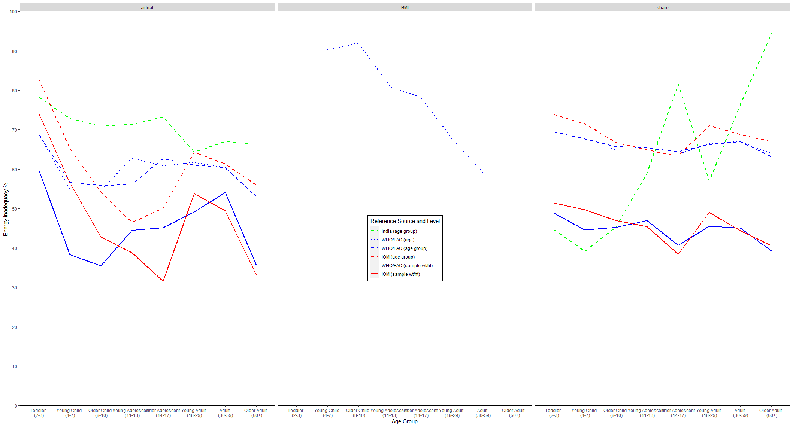
Frequency of BMI and Energy Inadequacy for Women in the BIHS Sample
Notes:
You are not supposed to use the energy requirement in this way, because it is not an EAR and it violates the two assumptions: intakes and requirements being independent and that the distribution of intakes is greater than the distribution of requirements, and we don’t know the distribution of requirements for energy.

Slide 18
Inequality Measures
How do we measure nutritional inequality?
No consensus on intrahousehold bargaining models, which require identifying individual inadequacy
Intergroup models such as boys vs. girls allow for group level inadequacy (Brown et. al. , 2019)
Mean log deviation (Brown, 2019)
Ratio of net nutrient adequacy across groups (Berti, 2012; Coates, 2018)
Calorie Kuznets curves (Sahn, 2009)

Slide 19
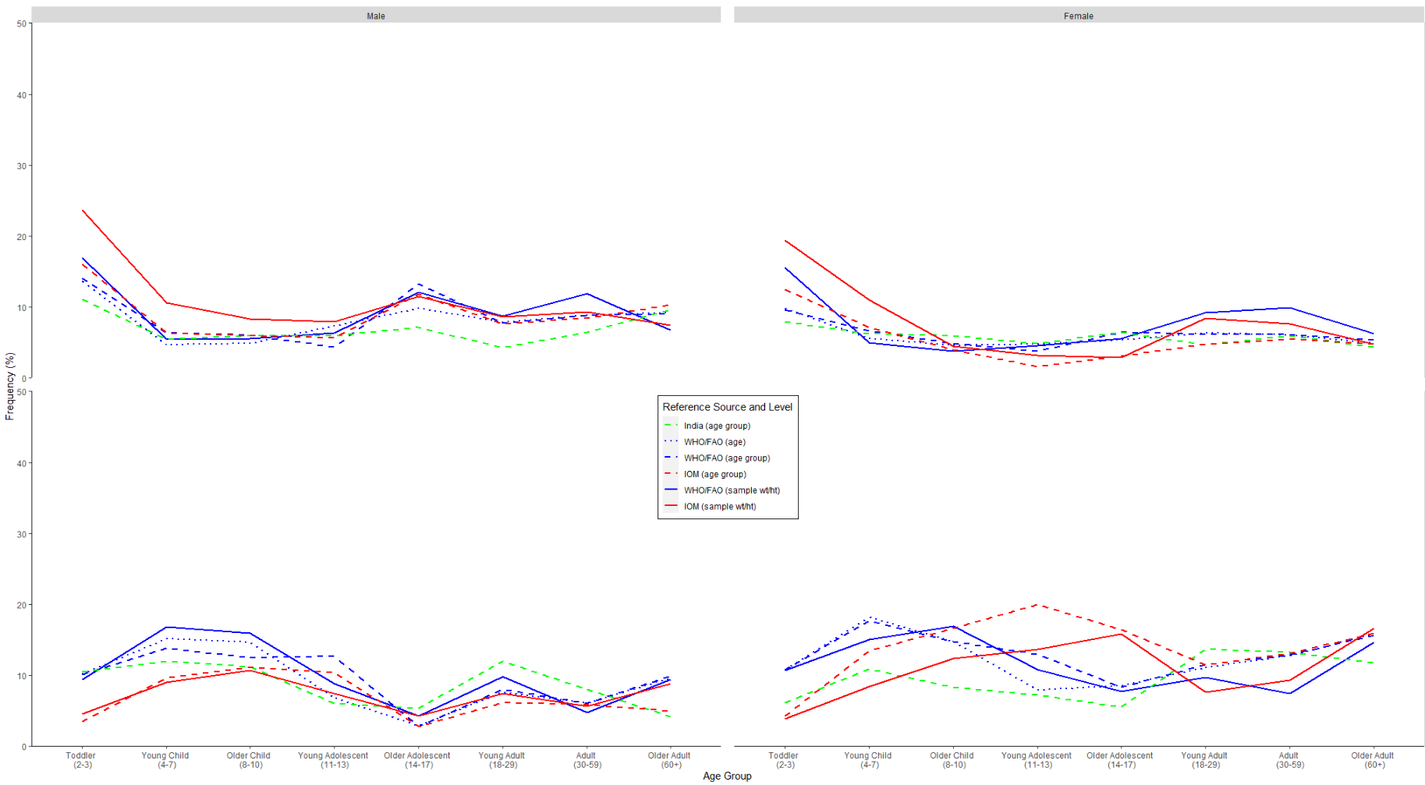
Frequency of unequal adequacy outcomes (actual intake)
Inadequate individual in Adequate Household
Adequate individual in Inadequate Household
Notes:
Binary measure of inequality, using individual adequacy

Slide 20
Next Steps
Nutrient inadequacy measures
Other inequality measures
Concordance coefficients between inadequacy and inequality measures
Machine learning approach to identify household and individual characteristics as predictors of inadequacy and inequality

